Slide 1
Statistics & SPSS Review
Fall 2009

Slide 2
Types of Measures / Variables
Nominal / categorical
  Gender, major, blood type, eye color
Ordinal
  Rank-order of favorite films; Likert scales?
Interval / scale
  Time, money, age, GPA

Slide 3
Main Analysis Techniques
Variable Type | Example | Commonly-used Statistical Method
Nominal by Nominal | blood type by gender | Chi-square
Scale by Nominal | GPA by gender GPA by major | t-test Analysis of Variance
Scale by Scale | weight by height GPA by SAT | Regression Correlation

Slide 4
Main Analysis Techniques
Variable Type | Example | Commonly-used Statistical Method
Nominal by Nominal | blood type by gender | Chi-square
Scale by Nominal | GPA by gender GPA by major | t-test Analysis of Variance
Scale by Scale | weight by height GPA by SAT | Regression Correlation

Slide 5
SPSS Cross –tab with Chi-Square

Slide 6
SPSS Cross –tab with Chi-Square
p < .05

Slide 7
Main Analysis Techniques
Variable Type | Example | Commonly-used Statistical Method
Nominal by Nominal | blood type by gender | Chi-square
Scale by Nominal | GPA by gender GPA by major | t-test Analysis of Variance
Scale by Scale | weight by height GPA by SAT | Regression Correlation

Slide 8
SPSS t-test Output

Slide 9
SPSS t-test Output
1. Read means
2. Read Levene’s Test
3. Read p value

Slide 10
Analysis of Variance
Variable Type | Example | Commonly-used Statistical Method
Nominal by Nominal | blood type by gender | Chi-square
Scale by Nominal | GPA by gender GPA by major | t-test Analysis of Variance
Scale by Scale | weight by height GPA by SAT | Regression Correlation

Slide 11
SPSS ANOVA output

Slide 12
SPSS ANOVA output
p value

Slide 13
Variables & Statistical Tests
Variable Type | Example | Common Stat Method
Nominal by nominal | Blood type by gender | Chi-square
Scale by nominal | GPA by gender GPA by major | T-test Analysis of Variance
Scale by scale | Weight by height GPA by SAT | Regression Correlation

Slide 14
Variance
∑ ( x _{i} - Mean )²
Variance = s² = -----------------------
N
Standard Deviation = s = √ variance

Slide 15
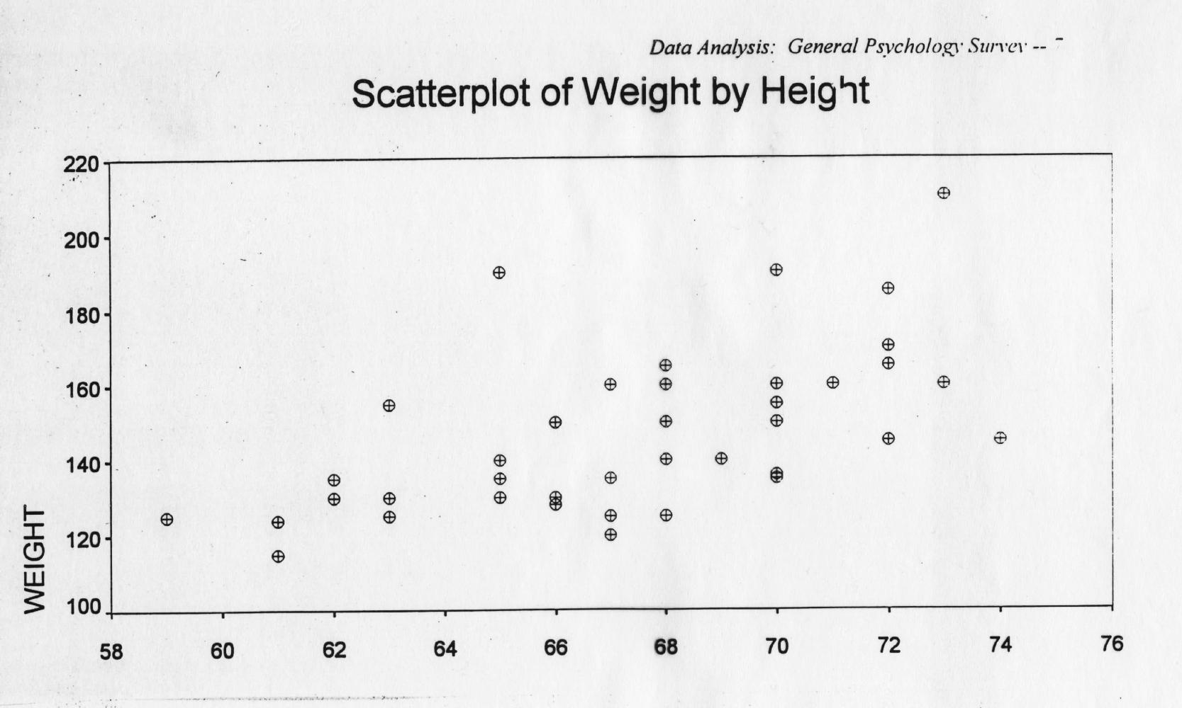
Regression line
W = 3.3 H - 73

Slide 16
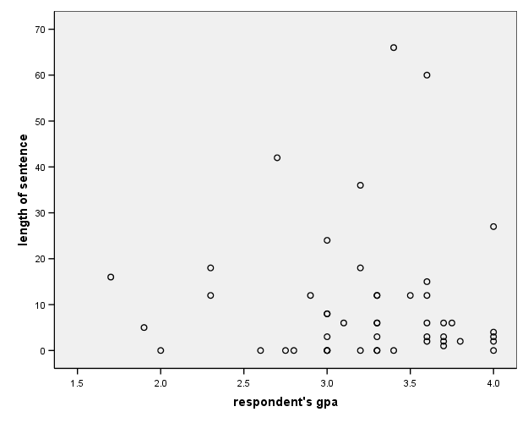
Scatterplot: Sentence by G.P.A.

Slide 17
Regression Coefficients
Sentence = -3.5 G.P.A. + 18

Slide 18
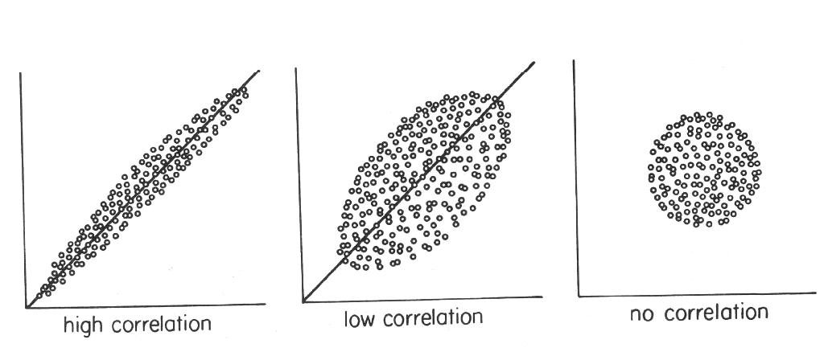
Correlation

Slide 19
Correlation: Sentence & G.P.A.

Slide 20
Correlation: Sentence & G.P.A.
p value

Slide 21
Correlation
Interpreting r as r²
r = -.22 r² = .05
G.P.A. “explains” 5% of variance in SENTENCE length

